Slide 1
Chapter 27 Hashing

Slide 2
Why Hashing?
. Is there a more efficient way to search for an element in a container? This chapter introduces a technique called hashing. You can use hashing to implement a map or a set to search, insert, and delete an element in O(1) time.

Slide 3
Map
A map is a data structure that stores entries. Each entry contains two parts: key and value. The key is also called a search key, which is used to search for the corresponding value. For example, a dictionary can be stored in a map, where the words are the keys and the definitions of the words are the values.
A map is also called a dictionary, a hash table, or an associative array. The new trend is to use the term map.

Slide 4
What is Hashing?
If you know the index of an element in the array, you can retrieve the element using the index in O(1) time. So, can we store the values in an array and use the key as the index to find the value? The answer is yes if you can map a key to an index.
The array that stores the values is called a hash table. The function that maps a key to an index in the hash table is called a hash function.
Hashing is a technique that retrieves the value using the index obtained from key without performing a search.

Slide 5
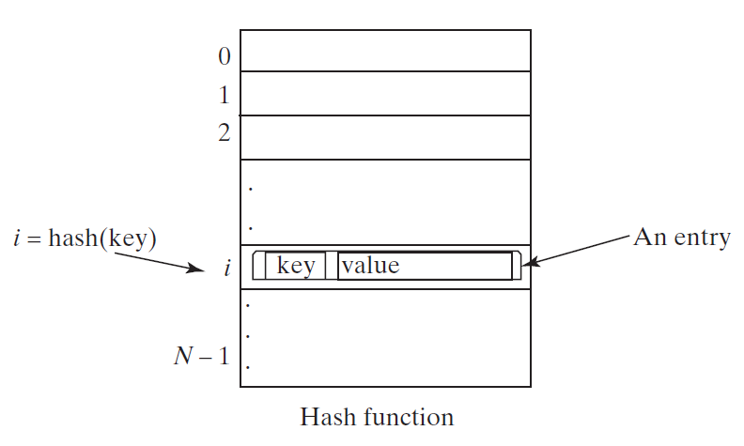
Hash Function and Hash Codes
A typical hash function first converts a search key to an integer value called a hash code, and then compresses the hash code into an index to the hash table.

Slide 6
How are hash codes created?
Each class instance in Java has a method inherited from Object with the signature: public int hashCode()
There is a default hash code generated in Object
You can override this method and create a hash code for your implementation of a hashSet or hashMap

Slide 7
Guidelines for hashCode()
A hash function h maps keys of a given type to integers in a fixed interval [0, N − 1]
Example: h(x) = x mod N is a hash function for integer keys
The integer h(x) is called the hash value of key x
A hash table for a given key type consists of
Hash function h
Array (called table) of size N
When implementing a map with a hash table, the goal is to store item (k, o) at index i = h(k)

Slide 8
Example
We design a hash table for a map storing entries as (Phone #, Name), where PN (phone number) is a 10-digit positive integer
Our hash table uses an array of size N = 10,000 and the hash function h(x) = last four digits of x
0
∅
1
025-612-0001
2
981-101-0002
3
∅
4
451-229-0004
…
9997
∅
9998
200-751-9998
9999
∅

Slide 9
Hash function
A hash function is usually specified as the composition of two functions:
Hash code: h₁: keys → integers
Compression function: h₂: integers → [0, N − 1]
The hash code is applied first, and the compression function is applied next on the result, i.e., h(x) = h₂(h₁(x))
The goal of the hash function is to “disperse” the keys in an apparently random way

Slide 10
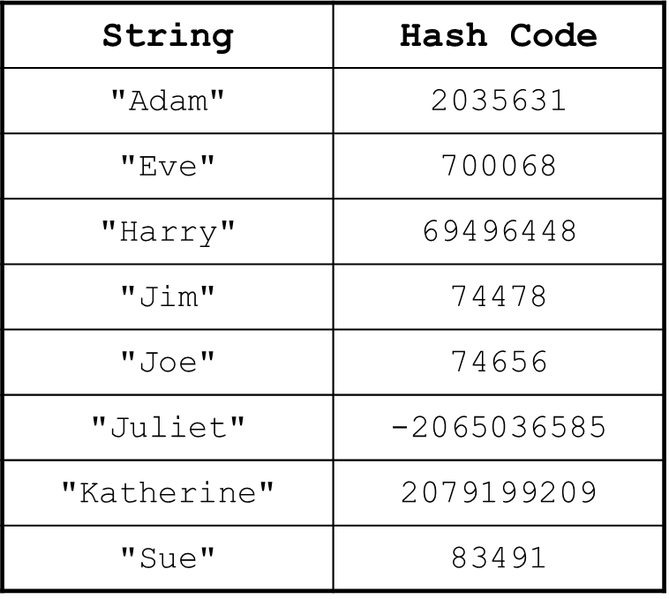
Sample Strings and their hash codes

Slide 11
Computing HashCodes
A hash function computes an integer hash code from an object
Choose a hash function so that different objects are likely to have different hash codes.
Bad choice for hash function for a string
Adding the unicode values of the characters in the string:
int h = 0; for (int i = 0; i < s.length(); i++) h = h + s.charAt(i);
Because permutations ("eat" and "tea") would have the same hash code

Slide 12
Computing HashCodes
Hash function for a string s from standard library
final int HASH_MULTIPLIER = 31; int h = 0; for (int i = 0; i < s.length(); i++) h = HASH_MULTIPLIER * h + s.charAt(i)
For example, the hash code of "eat" is
31 * (31 * 'e' + 'a') + 't' = 100184
The hash code of "tea" is quite different, namely
31 * (31 * 't' + 'e') + 'a' = 114704

Slide 13
Creating HashCodes for your classes
Use a prime number as the HASH_MULTIPLIER
Compute the hash codes of each instance field
For an integer instance field just use the field value
Combine the hash codes:
int h = HASH_MULTIPLIER * h1 + h2; h = HASH_MULTIPLIER * h + h3; h = HASH_MULTIPLIER *h + h4; ... return h;

